Slide 1
GROWTH AND REPRODUCTION

Slide 2
BASIC KNOWLEDGE REQUIRED
CHROMOSOME: Rod like structure visible during cell division. Made up of DNA. Carries hereditary information.
GENE: A unit of inheritance. Small segment of DNA in a chromosome that controls a particular characteristic in an organism.

Slide 3
MITOSIS
Cell division giving rise to genetically identical cells in which the chromosome number is maintained. ( DNA Replicates)
Role of mitosis: growth, repair of damaged tissues, replacement of worn-out cells and asexual reproduction ( VEGETATIVE PROPOGATION IN PLANTS e.g. potatoes)
Mistakes in DNA replication may cause uncontrolled division – CANCER, MUTATIONS, ABNORMAL PROTEINS ( REJECTED BY IMMUNE SYSTEM)
https://www.cellsalive.com/mitosis_js.htm

Slide 4
VEGETATIVE PROPOGATION
THE NEW PLANT IS FORMED BY COPYING CELLS FROM PARENT PLANT
MINIATURE PLANT CAN BE NOURISHED BY THE PARENT PLANT UNTIL IT IS ESTABLISHED ENOUGH TO LIVE INDEPENDENTLY
THE PLANT DOES NOT NEED TO PRODUCE ANY FLOWERS.
FOR EXAMPLE: runners and stem tubers.
Bud grows from parent plant often at ground level. Bud develops into complete miniature plant. Young plant breaks away from parent plant and can live an independent life.
Potatoes : tubers : eyes on potato develop into new shoots. New plant identical to parent. Irish famines of the 19th century resulted from blight fungus infecting almost all of the potato crop.
Cuttings are put into compost or even water: develop into new plants. (e.g. money plant.

Slide 5
Asexual reproduction is the process resulting in the production of genetically identical offspring from one parent
ADVANTAGES
One parent required
All beneficial qualities are passed on to offspring
Faster method of producing offspring
Can colonise the area rapidly
DISADVANTAGE
No genetic variation : not well adapted to changes in the environment.

Slide 6
MEIOSIS
Meiosis as a reduction division in which the chromosome number is halved from diploid to haploid ( after replication – 4 cells)
Details of meiotic division are not required other than its role in halving of the chromosome number.
Define the terms gamete (sex/reproductive cells with half the no. of chromosomes), diploid (complete set of chromosomes) and haploid ( half the no. of chromosomes) should be explained
State that gametes are the result of meiosis (reduction division)
https://www.cellsalive.com/meiosis_js.htm

Slide 7
SEXUAL REPRODUCTION
Define sexual reproduction as the process involving the fusion of haploid nuclei to form a diploid zygote and the production of genetically dissimilar offspring. ( due to crossing over and independent assortment of chromosomes) Fig 16.27 page 311.
Learners should appreciate that each parent therefore makes an equal contribution to the diploid cell from which an offspring will develop
Draw a flow chart showing gametes, zygote and embryo onto which they may annotate each stage to show the chromosome number (n or 2n) and type of cell division (mitosis or meiosis) involved.

Slide 8
SEXUAL REPRODUCTION is the process involving the fusion of haploid nuclei to form a diploid zygote and the production of genetically dissimilar offspring. ( due to crossing over and independent assortment of chromosomes) Fig 16.27 page 311.
ADVANTAGES
Genetic variation : species better adapted to changes in the environment
Offspring may inherit beneficial qualities from both parents.
DISADVANATGES
Two parents needed ( except in plants with bisexual flowers)
Fusion of gametes required
Slower method as compared to asexual reproduction.
Table: 17.1 page 317.

Slide 9
IMPORTANCE OF MEIOSIS
Meiosis produces haploid nucleus. Fusion of gametes leads to diploid nucleus.
Meiosis results in variations which increases the chances of survival of the species during changes in the environment.
Nature selects organisms with favourable characteristics to survive, while the others die. Those that survive pass on their favourable genes to their offspring. Thus species lives on
MITOSIS vs MEIOSIS – table 16.1 page 312.
Let’s review: Section A: Q 2.

Slide 10
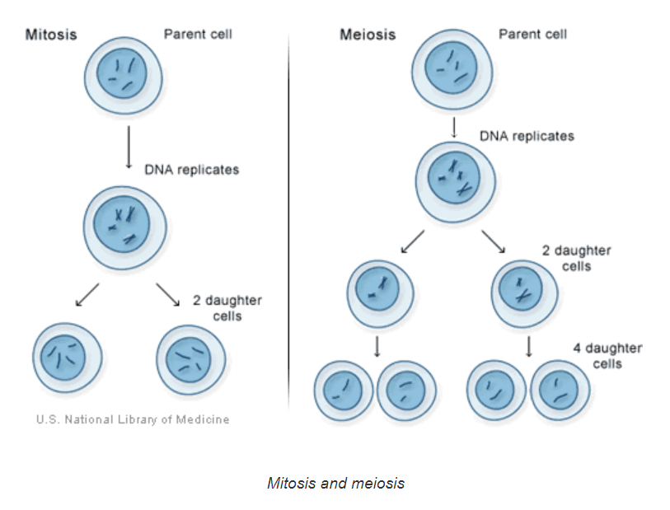

Slide 11
SUMMARY
ASEXUAL REPRODUCTION
INVOLVES ONLY ONE PARENT
ALL CHARACTERISTICS OF PARENT PASSED ON TO ALL OFFSPRINGS
PRODUCES GENETICALLY IDENTICAL OFFSPRINGS
MANY ORGANISMS PRODUCE ASEXUALLY WHEN CONDITIONS ARE FAVOURABLE (e.g. when there is plenty of food) AND BUILD UP THEIR NUMBERS QUICKLY. e.g bacteria, fungi, yeast.

Slide 12
SUMMARY
SEXUAL REPRODUCTION
REQUIRES TWO PARENTS: MALE AND FEMALE
EACH INDIVIDUAL PRODUCES GAMETES
ALWAYS INVOLVES FERTILIZATION – fusion of gametes to produce zygote
OFFSPRING RECEIVES A MIXTURE OF GENES TO SHOW A MIXTURE OF PARENTAL CHARACTERISTICS
GENETIC VARIATION – offspring different to other offspring and to the parents

Slide 13
STRUCTURE OF FLOWER
Identify and draw, using a hand lens if necessary, the sepals, petals, stamens and carpels of one, locally available, named, insect-pollinated dicotyledonous flower, and examine the pollen grains under a light microscope.
If possible a large, brightly-coloured, scented flower with visible nectar should be chosen. Ensure that learners produce large drawings, with a sharp HB pencil, draw clean lines and give the magnification of their drawing (e.g. x3).
MOST PLANTS ARE HERMAPHRODITE (BISEXUAL)

Slide 14
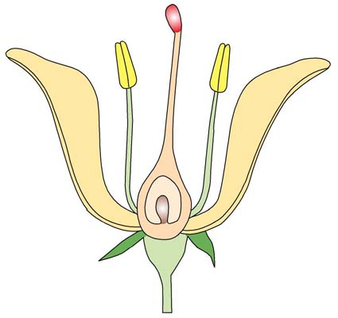
Parts of a Flower
stigma
carpel
style
anther
ovary
stamen
ovule
filament
Sepal
Sepals are modified leaves which enclose and protect the other parts of the flower in the bud stage.
All the sepals together make up the calyx.
The sepals usually form the outermost layer of floral leaves.
However, some flowers, for example, Hibiscus, have another layer of floral leaves outside the sepals, which make up the epicalyx of the flower.
Copyright © 2006-2011 Marshall Cavendish International (Singapore) Pte. Ltd.
28 February 2018
14

Slide 15
Parts of a Flower
stigma
carpel
style
anther
ovary
stamen
ovule
filament
Sepal
Receptacle
The receptacle is the enlarged end of the flower stalk which bears the other parts of the flower.
Copyright © 2006-2011 Marshall Cavendish International (Singapore) Pte. Ltd.
28 February 2018
15

Slide 16
Parts of a Flower
stigma
carpel
style
anther
ovary
stamen
ovule
filament
Sepal
Receptacle
Pedicel
The pedicel is the flower stalk. Some flowers have no pedicels and are attached to the plant directly at the base. They are called sessile flowers.
Copyright © 2006-2011 Marshall Cavendish International (Singapore) Pte. Ltd.
28 February 2018
16

Slide 17
Parts of a Flower
stigma
carpel
style
anther
ovary
stamen
ovule
filament
Petal
Petals are modified leaves which form the most obvious part of the flower. All the petals together make up the corolla. In insect-pollinated flowers, petals:
are brightly coloured to attract insects for pollination; and
provide a platform for insects to land.
Sepal
Receptacle
Pedicel
Copyright © 2006-2011 Marshall Cavendish International (Singapore) Pte. Ltd.
28 February 2018
17

Slide 18
Parts of a Flower
stigma
Petal
carpel
style
ovary
anther
ovule
stamen
filament
Sepal
Receptacle
Pedicel
Copyright © 2006-2011 Marshall Cavendish International (Singapore) Pte. Ltd.
28 February 2018
18

Slide 19
Parts of a Stamen
Side view of a stamen
Stamen
The androecium (plural: androecia) is the male part of the flower.
It is made up of units called stamens.
It consists of an anther and a filament.
Copyright © 2006-2011 Marshall Cavendish International (Singapore) Pte. Ltd.
28 February 2018
19

Slide 20
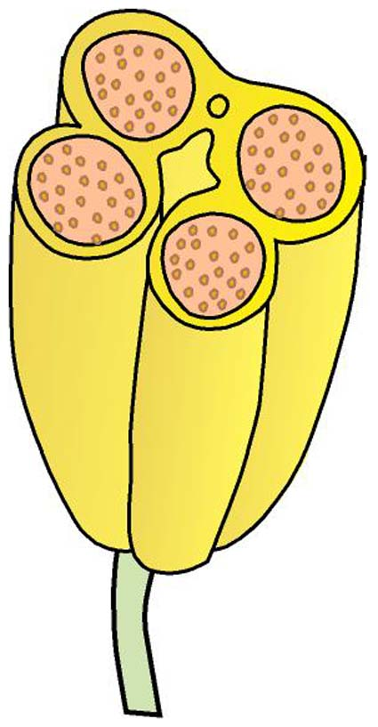
Parts of a Stamen
vascular bundle
Stamen with upper half of anther cut off
Side view of a stamen
Stamen
Filament
The filament is the stalk that holds the anther in a suitable position to disperse the pollen.
pollen (grains) are not gametes but that they contain the gametes.
Copyright © 2006-2011 Marshall Cavendish International (Singapore) Pte. Ltd.
28 February 2018
20

Slide 21
Parts of a Stamen
pollen sacs
vascular bundle
pollen grains
Anther
The anther consists of two lobes. Each lobe contains two pollen sacs. In the pollen sacs are the pollen grains. The anther produces pollen grains. When the anther matures, it splits open to release the pollen grains.The anther also contains a vascular bundle. The vascular bundle contains:
phloem which translocates sucrose and amino acids to the developing anther. Sucrose provides the energy for cell division. Amino acids are used for synthesis of proteins and new protoplasm.
xylem which transports water and mineral salts to the anther.
anther lobes
Stamen with upper half of anther cut off
Side view of a stamen
Stamen
Filament
Copyright © 2006-2011 Marshall Cavendish International (Singapore) Pte. Ltd.
28 February 2018
21

Slide 22
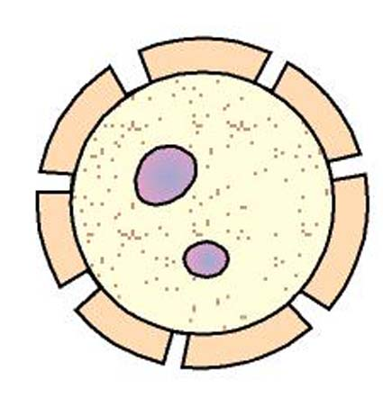
Parts of a Stamen
pollen sacs
vascular bundle
pollen grains
pollen tube nucleus
anther lobes
generative nucleus
Stamen with upper half of anther cut off
Side view of a stamen
Mature pollen grain
Pollen grains
Pollen grains contain the male gametes, which are produced by meiosis.
The nuclei in pollen grains contain the haploid number of chromosomes.
Each pollen grain contains two nuclei, the generative nucleus and the pollen tube nucleus or vegetative nucleus.
Stamen
Filament
Anther
Copyright © 2006-2011 Marshall Cavendish International (Singapore) Pte. Ltd.
28 February 2018
22

Slide 23
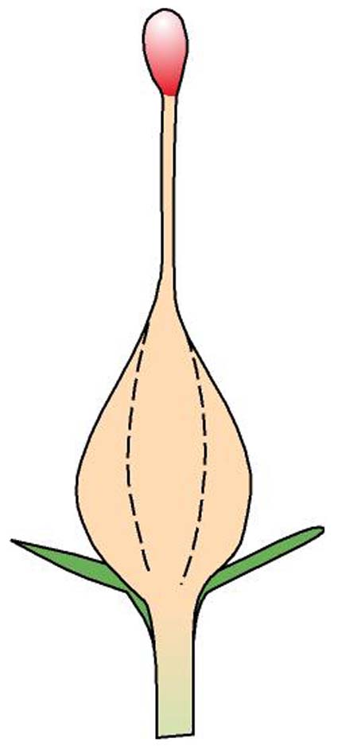
Parts of a Carpel
stigma
Carpel
The pistil or gynoecium (plural: gynoecia) is the female part of the flower. It is made up of one or more units called carpels. A carpel consists of:
- an ovary;
a style above the ovary; and
one or more stigmas.
style
ovary
Side view of a carpel
Copyright © 2006-2011 Marshall Cavendish International (Singapore) Pte. Ltd.
28 February 2018
23

Slide 24
Parts of a Carpel
Stigma
The stigma is a swollen structure at the end of the style.
It receives the pollen grains.
The mature stigma secretes a sugary fluid that stimulates the pollen grains to germinate.
style
Carpel
ovary
Side view of a carpel
Copyright © 2006-2011 Marshall Cavendish International (Singapore) Pte. Ltd.
28 February 2018
24

Slide 25
Parts of a Carpel
Stigma
Style
The style is a stalk that connects the stigma to the ovary.
It holds the stigma in a suitable position to trap pollen grains.
Carpel
ovary
Side view of a carpel
Copyright © 2006-2011 Marshall Cavendish International (Singapore) Pte. Ltd.
28 February 2018
25

Slide 26
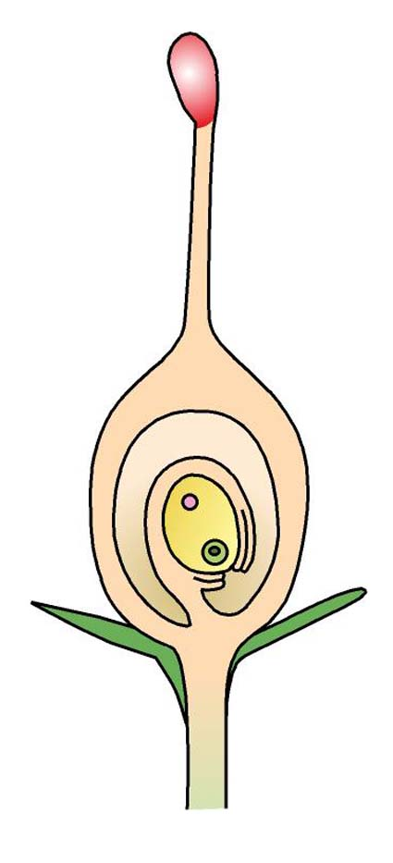
Parts of a Carpel
stigma
style
Ovary
The ovary contains one or more ovules.
Each mature ovule contains a female gamete or egg cell called the ovum (plural: ova) and the definitive nucleus. The ovum is produced by meiosis. It is therefore haploid.
The ovules are attached to a region in the ovary called the placenta. The ovule is attached to the placenta by a stalk called the funicle.
ovary wall
definitive nucleus
ovule
ovum
funicle
L.S. of a carpel
placenta
Copyright © 2006-2011 Marshall Cavendish International (Singapore) Pte. Ltd.
28 February 2018
26

Slide 27
POLLINATION Transfer of pollen from anther to stigma

Slide 28
SELF-POLLINATION vs CROSS-POLLINATION
Self-pollination: Pollen is transferred from anther to stigma of the same plant:
very efficient (pollen does not have to travel far)
Does not offer much chance of genetic variation
Cross-pollination: Pollen is transferred from anther to stigma of another plant of the same species.
Risky: pollen may never reach the other plant
Offers a greater chance of genetic variation
(self-sterile plants: have special proteins on the surface of stigma that prevent pollen tube from forming if pollen comes form anther of the same plant) ( anther and stigma may be far away) ( few plants such as willow, holly have separate male and female plants)

Slide 29
INSECT POLLINATED AND WIND POLLINATED
INSECT-POLLINATED
WIND-POLLINATED
Petals: large, brightly coloured, scented, often with nectaries.
Anthers: stiff, firmly attached and positioned where insects must brush against them
Pollen: small amounts of large sticky grains
Stigma: usually flat or lobe shaped positioned where insects must brush against them.
Small, green or dull in colour
Hang loosely on long thin filaments
Enormous quantity of light smooth pollen grains
Long and feathery and hanging outside flower.

Slide 30
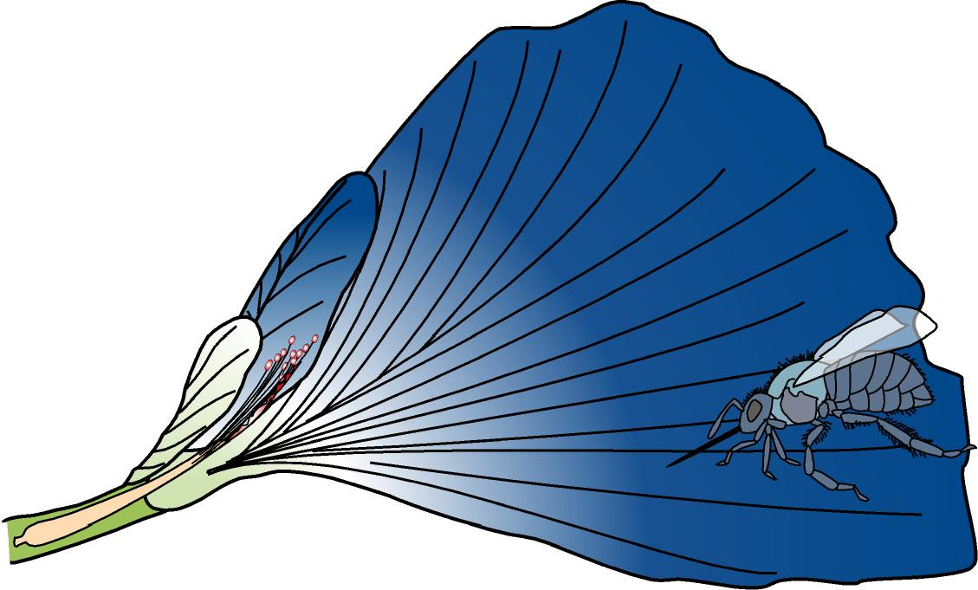
Pollination in an Insect-pollinated Flower (Clitoria)
wing petal
standard petal
keel petal
insect
nectar guide
stigma
stamen trough
stamen
1
In its natural state, the flower is inverted with the standard petal at the bottom.
When a heavy insect such as a bee visits the flower, it lands on the standard petal.
Copyright © 2006-2011 Marshall Cavendish International (Singapore) Pte. Ltd.
28 February 2018
30

Slide 31
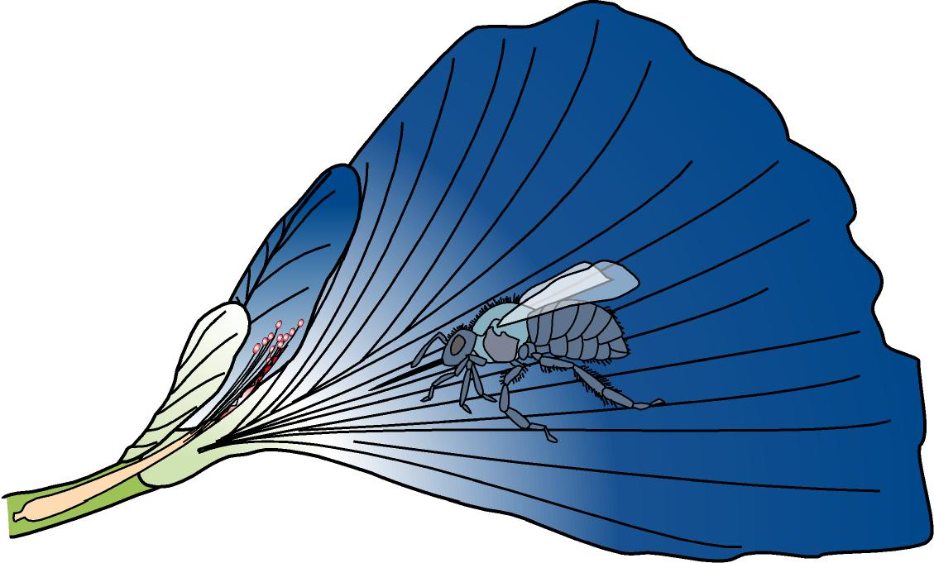
Pollination in an Insect-pollinated Flower (Clitoria)
wing petal
standard petal
keel petal
insect
nectar guide
stigma
stamen trough
stamen
2
The insect follows the nectar guide into the flower.
Copyright © 2006-2011 Marshall Cavendish International (Singapore) Pte. Ltd.
28 February 2018
31

Slide 32
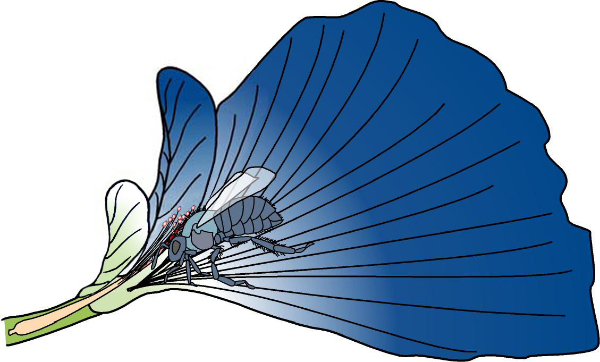
Pollination in an Insect-pollinated Flower (Clitoria)
wing petal
standard petal
keel petal
insect entering flower to collect nectar
nectar guide
stigma
stamen trough
stamen
3
The insect forces its way in between the two wing petals and moves in to collect the nectar.
Copyright © 2006-2011 Marshall Cavendish International (Singapore) Pte. Ltd.
28 February 2018
32

Slide 33
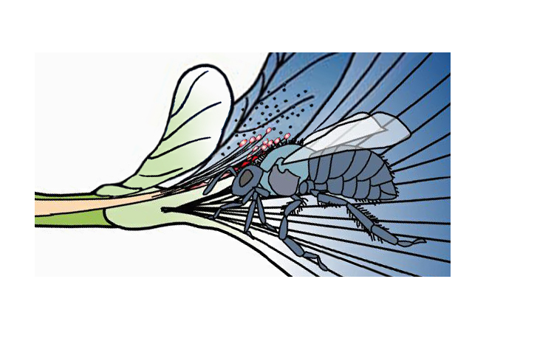
Pollination in an Insect-pollinated Flower (Clitoria)
pollen grain
stamen
hair
insect
wing petal
keel petal
stamen trough
stigma
4
The insect’s back forces the keel petal upwards to expose the stigma and the anthers.
The stigma and anthers brush against the hairy back of the insect.
When this happens, some pollen grains from the anther stick to the hairy back of the insect.
At the same time, pollen grains on the insect’s back (from another flower which the insect had visited earlier) are transferred to the sticky stigma.
Copyright © 2006-2011 Marshall Cavendish International (Singapore) Pte. Ltd.
28 February 2018
33

Slide 34
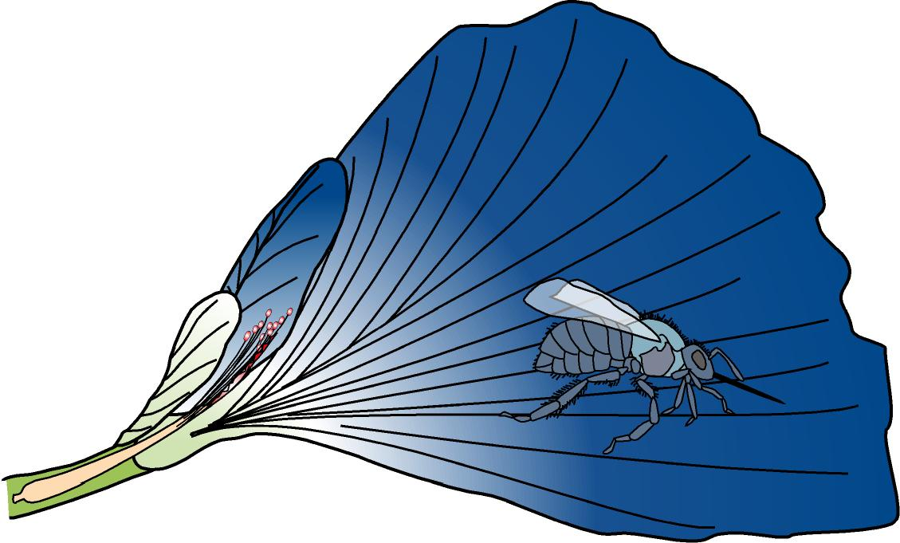
Pollination in an Insect-pollinated Flower (Clitoria)
wing petal
standard petal
keel petal
insect
nectar guide
stigma
stamen trough
stamen
5
When the insect leaves the flower, the keel springs back to its original position to enclose the stamens and the stigma again.
Copyright © 2006-2011 Marshall Cavendish International (Singapore) Pte. Ltd.
28 February 2018
34

Slide 35
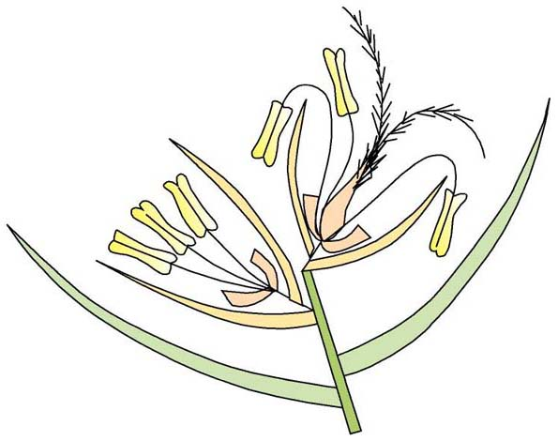
Pollination in a Wind-pollinated Flower (Ischaemum muticum)
upper bisexual flower
anther
lower male flower
feathery stigmas hanging out of the bracts
filament
lodicule
non-flowering bract (scale)
flowering bract (scale)
The mature stamens have long filaments that hang downwards and can swing freely. We say the filaments are pendulous.
The filaments hang out of the bracts, exposing the mature anthers to the wind.
Copyright © 2006-2011 Marshall Cavendish International (Singapore) Pte. Ltd.
28 February 2018
35

Slide 36
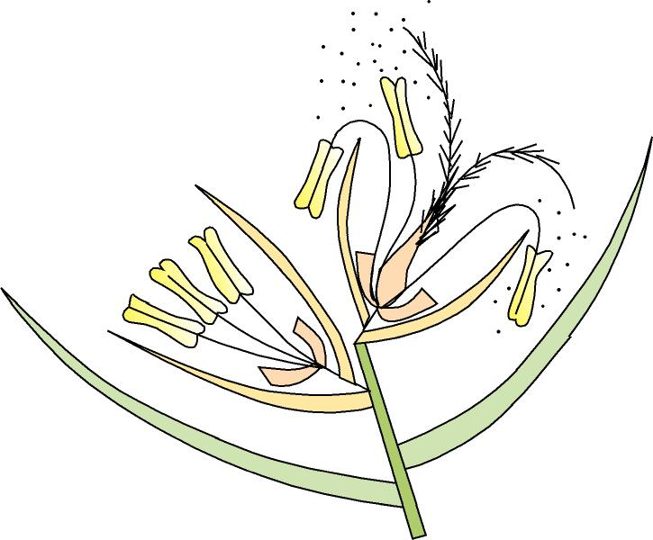
Pollination in a Wind-pollinated Flower (Ischaemum muticum)
pollen grains
upper bisexual flower
anther
lower male flower
feathery stigmas hanging out of the bracts
filament
lodicule
non-flowering bract (scale)
flowering bract (scale)
When the filaments sway in the wind, the dust-like pollen is shaken free and carried away by the wind.
Copyright © 2006-2011 Marshall Cavendish International (Singapore) Pte. Ltd.
28 February 2018
36

Slide 37
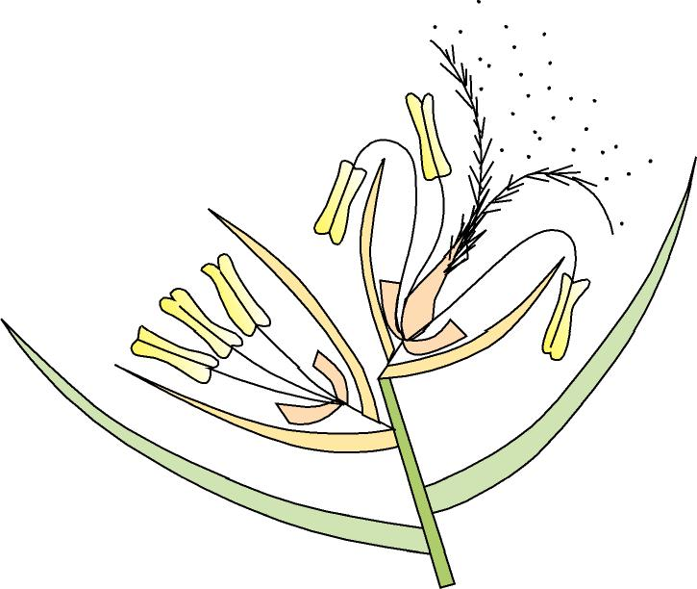
Pollination in a Wind-pollinated Flower (Ischaemum muticum)
pollen grains
upper bisexual flower
anther
lower male flower
feathery stigmas hanging out of the bracts
filament
lodicule
non-flowering bract (scale)
flowering bract (scale)
The mature stigmas do not hang freely but project out of the bracts. They are large, extended and feathery.
Thus, they provide a large surface area to receive any pollen that is floating around in the wind.
Copyright © 2006-2011 Marshall Cavendish International (Singapore) Pte. Ltd.
28 February 2018
37

Slide 38
FERTILISATION
Describe the growth of the pollen tube and its entry into the ovule followed by fertilisation (production of endosperm and details of development are not required)
Use a diagram to show the path taken by the pollen tube.

Slide 39
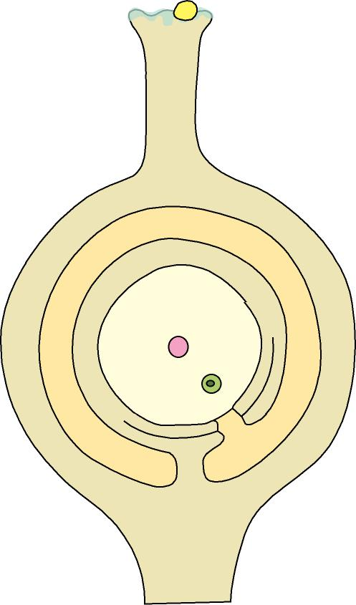
Fertilisation
pollen grain
sugary fluid
stigma
1
After pollination, the pollen grains germinate in response to the sugary fluid secreted by the mature stigma.
Copyright © 2006-2011 Marshall Cavendish International (Singapore) Pte. Ltd.
28 February 2018
39

Slide 40
Fertilisation
germinating pollen grain
stigma
pollen tube
2
A pollen tube grows out from each pollen grain.
Copyright © 2006-2011 Marshall Cavendish International (Singapore) Pte. Ltd.
28 February 2018
40

Slide 41
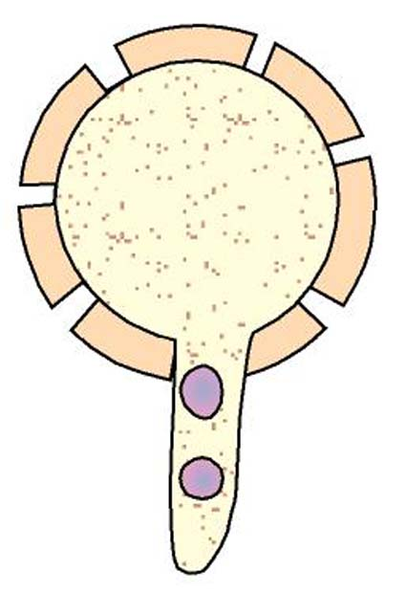
Fertilisation
Mature pollen grain
Pollen grain germinates
pollen tube nucleus
cytoplasm
generative nucleus
generative nucleus
pollen tube nucleus
cytoplasm
pollen tube
2
The cytoplasm and the two nuclei (pollen tube nucleus and generative nucleus) of each pollen grain pass into the pollen tube.
Copyright © 2006-2011 Marshall Cavendish International (Singapore) Pte. Ltd.
28 February 2018
41

Slide 42
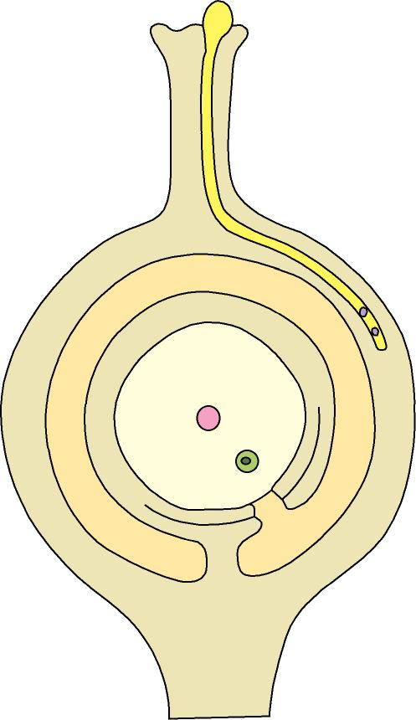
Fertilisation
germinating pollen grain
style
stigma
pollen tube
ovary wall
3
The pollen tube grows right through the style into the ovary.
Copyright © 2006-2011 Marshall Cavendish International (Singapore) Pte. Ltd.
28 February 2018
42

Slide 43
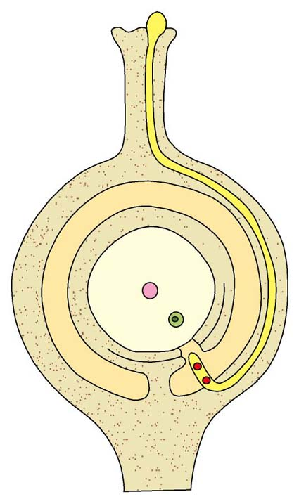
Fertilisation
germinating pollen grain
style
stigma
pollen tube
ovary wall
male gametes
4
Along the way, the generative nucleus divides to form two male gametes.
The pollen tube nucleus breaks down.
Copyright © 2006-2011 Marshall Cavendish International (Singapore) Pte. Ltd.
28 February 2018
43

Slide 44
Fertilisation
germinating pollen grain
style
stigma
pollen tube
ovary wall
micropyle
male gametes
5
The pollen tube enters the ovule usually through an opening in the ovule wall called the micropyle.
Copyright © 2006-2011 Marshall Cavendish International (Singapore) Pte. Ltd.
28 February 2018
44

Slide 45
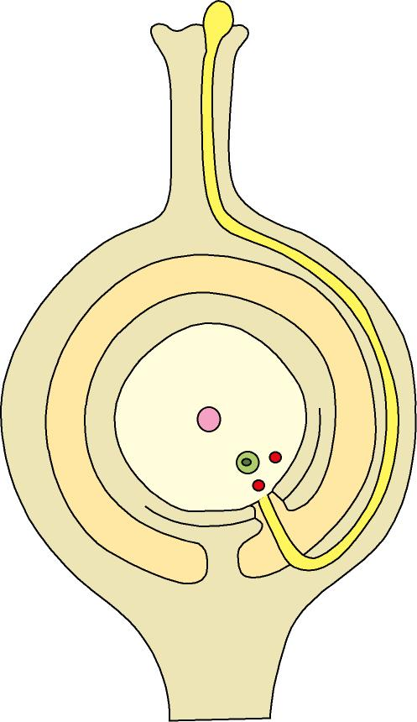
Fertilisation
germinating pollen grain
style
stigma
pollen tube
ovary wall
ovule
male gametes
micropyle
funicle
placenta
6
The tip of the pollen tube absorbs sap and bursts, releasing the two male gametes into the ovule.
Copyright © 2006-2011 Marshall Cavendish International (Singapore) Pte. Ltd.
28 February 2018
45

Slide 46
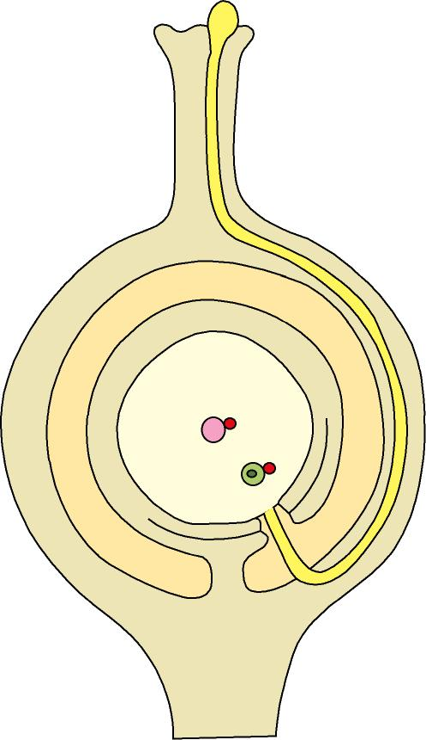
Fertilisation
germinating pollen grain
style
stigma
pollen tube
ovary wall
definitive nucleus
ovule
male gametes
ovum (egg)
micropyle
funicle
placenta
7
One male gamete fuses with the ovum (female gamete) to form a diploid zygote. This is fertilisation.
The other male gamete fuses with the definitive nucleus to form the endosperm nucleus.
Copyright © 2006-2011 Marshall Cavendish International (Singapore) Pte. Ltd.
28 February 2018
46

Slide 47
Fertilisation
germinating pollen grain
style
stigma
pollen tube
ovary wall
definitive nucleus
ovule
male gametes
ovum (egg)
micropyle
funicle
placenta
8
The zygote will divide and develop into the embryo in the seed.
The endosperm nucleus will divide and give rise to the food storage tissue called the endosperm.
Copyright © 2006-2011 Marshall Cavendish International (Singapore) Pte. Ltd.
28 February 2018
47

Slide 48
FORMATION OF FRUIT AND SEED
After male nucleus has fused with the ovum, zygote divides many times to produce an embryo.
Once fertilization is complete, developing seed sends hormone messages to the flower which leads to:
The sepals, petals, stamen, stigma, style wither away. (would use up valuable food compounds if remained)
Strawberries – sepals remain
Aubergines

Slide 49
The wall of the ovary changes: it may become hardened and dry ( nuts) or fleshy and succulent ( plum).
Ovary is now called fruit. It is a fertilized ovary and has the function of dispersing the seeds away from the parent plant.
Fertilized ovule develops into a seed with the zygote forming the embryo.

Slide 50
STRUCTURE OF SEED
To understand seed structure and germination, it is easiest if large seeds, such as peas and beans, are studied.
The hilum is the scar left by the seed’s attachment to the pod

Slide 51
Seed coat (testa) - encloses and protects the seed from insects and fungi. It is usually hard and dry- prevents drying out of the embryo
Cotyledons (seed leaves) Modified leaves containing food store for the embryo (one seed leaf in monocot – grasses and two in dicot- peas and beans
Micropyle Hole which admits water when the seed starts to germinate.

Slide 52
Plumule (young shoot) Radicle (young root) together with cotyledons make up the embryo – develops into a new young plant after germination.

Slide 53
Not all seeds are edible
Uncooked castor oil seeds contain a deadly poison-ricin which was used to kill a Romanian dissident Georgi Markov
Almonds contain cyanide

Slide 54
SEED DISPERSAL
BEFORE SEEDS GERMINATE THEY MUST BE SEPARATED FROM ITS PARENT PLANT OTHERWISE IT WOULD COMPETE WITH THE PARENT FOR RESOURCES (light energy, water, carbon dioxide)
DISPERSED BY WIND, WATER, ANIMALS.
LOTS OF FRUITS INCREASE CHANCES OF SUCCESS.
Fruit and seed dispersal by wind or animals can happen only after pollination (by wind or insects) and the two very different processes must not be confused

Slide 55
DISPERSAL OF SEEDS AND FRUIT
BY WIND: The sycamore has two extended wings formed from two fused carpels
BY AN EXPLOSIVE MECHANISM: In lupin carpel splits and twists, ejecting the seeds
BY ANIMALS: Avens – hooked style attached to hair or fur of animal. In plum seed remains undigested and passes out in faeces.
BY WATER: In coconut the fibrous ovary wall allows the fruit to float in water.
https://www.youtube.com/watch?v=buZV0h4vfmQ

Slide 56
Germination is the development of a seed to a new young plant.
When the seed is shed, it is usually dry and hard, containing very little water. In this dehydrated state it is best suited to withstand drought and extreme temperatures ( resting state - dormancy can last for years)
CONDITIONS: water, oxygen, suitable temperature. ( conditions that affect enzyme activity) – germination is enzyme controlled.
The pattern of germination is similar in most dicotyledonous seeds.
Whichever pattern of germination occurs, the energy and raw materials required for growth come from the food (usually starch) stored in the cotyledon.
1. When conditions become suitable for germination, the seed takes in water through its micropyle: activates enzymes to convert insoluble stores to soluble foods (starch to glucose etc)
2. The tissues absorb water and swell and the testa becomes soft.
3. Water and oxygen enter through gaps in testa: respiration – energy release – embryo grows- receives raw materials and oxygen.

Slide 57
STRUCTURAL CHANGES DURING GERMINATION
4.The radicle grows first, pushing though the testa and entering the soil- anchors the seedling and starts absorbing water and mineral salts.
5. The plumule emerges as the testa is split away from the cotyledons, the hooked shoot protects the young leaves from damage by soil particles
6. Plumule grows upwards retaining its hooked shape
7. Foliage leaves show/Plumule emerges above ground and starts to straighten out to lift foliage leaves above the soil
8. Lateral roots increase in size: anchorage and absorption of water and mineral salts
8. Foliage leaves open / plumule straight – holds leaves upwards, seedling now established / food stores in cotyledons provide nutrients for growth and energy./ shrivelled testa.

Slide 58
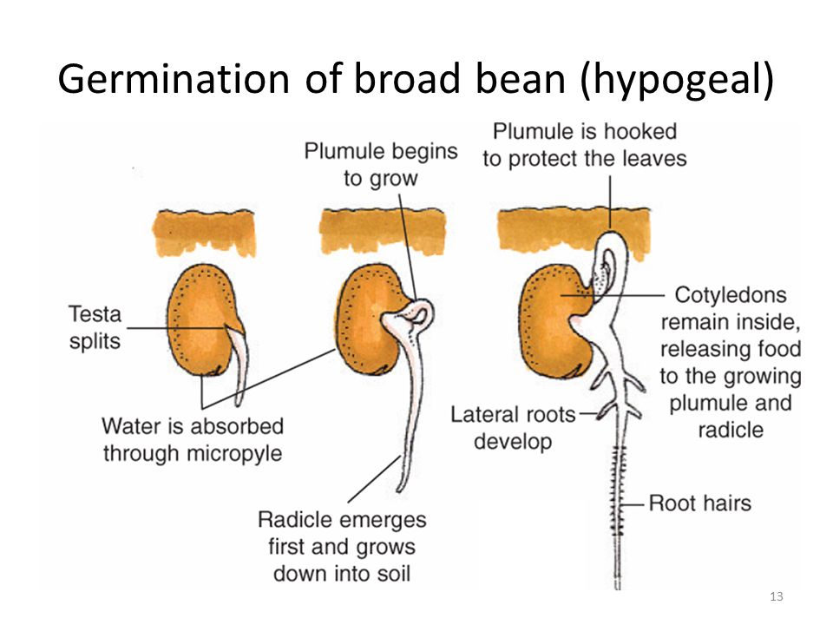

Slide 59
STAGES IN GERMINATION OF PEA SEED

Slide 60
VIDEOS
https://www.youtube.com/watch?time_continue=10&v=XTZih16DUB4
https://www.youtube.com/watch?v=pB4ASdELBbQ
https://www.youtube.com/watch?v=iFCdAgeMGOA

Slide 61
PRACTICALS
DISSECTION OF A DICOT FLOWER
OBSERVING POLLEN GRAIN UNDER A MICROSCOPE
COMPARING WIND-POLLINATED WITH INSECT-POLLINTAED
GERMINATION STAGES
FACTORS AFFECTING GERMINATION

Slide 62
WRITTEN WORK
TEST YOURSELF 17.2 page 320
SECTION B: structured questions
TO DISCUSS:
Test Yourself 17.1, 17.3, 17.4 plus Let’s review.

